Slide 1


Tips for Submitting your Dismissal Appeal
TIPS FOR SUBMITTING YOUR
DISMISSAL
APPEAL
A guide for UConn students who are
Subject to Dismissal

Slide 2



WE’RE HERE TO HELP
Being subject to dismissal can feel overwhelming, but you’re not alone. UConn has a network of support ready to help you navigate the appeal process.
Visit the academic standing website for key information, including:
Support, not judgment
We’re here to help you in providing the resources and tools you need to understand the dismissal process and how to complete your appeal submission.
Top Resources
and Support
Academic Standing Website
Academic Success Advisors
Academic Achievement Center
Tips on how to prepare a strong dismissal appeal
What information and documentation you should include
How you will be evaluated

Slide 3
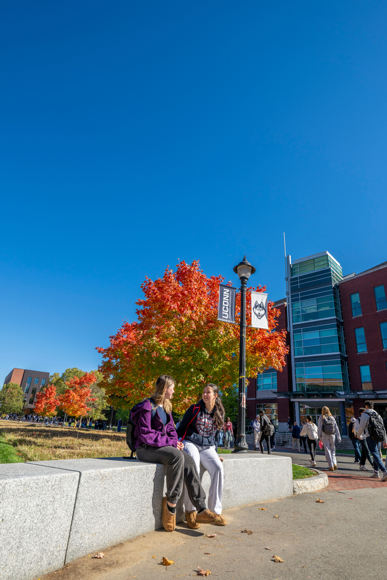

OVERVIEW
What is a dismissal appeal?
A formal process where students facing academic dismissal can request reconsideration of their dismissal
You may submit a dismissal appeal after you’re officially notified that you're subject to dismissal.
An opportunity to share your story
Tell us what impacted your academics, provide supporting documentation, and share how you plan to move forward.

Slide 4

WHERE TO START
Start Preparing Early
Watch for the pre-dismissal notification email, sent November 18, 2025, to prepare answers to appeal questions and obtain relevant documents such as medical or records or letters of support.
Wait for the Official Notification
You’ll receive an email on December 23, 2025 if you're subject to dismissal. You can submit your appeal between December 23, 2025 and January 2, 2026 at 4:00PM
Submit before the deadline
Dismissal appeals are due Friday, January 2, 2026 at 4:00PM EST. Late appeals are NOT accepted. There are no exceptions.
Don’t wait until the last minute—start preparing now. Starting early helps the appeal process go more smoothly.

Slide 5


DISMISSAL APPEAL NOTIFICATION
Each student who is subject to dismissal will receive a personal link by email to complete their dismissal appeal form.
Test and bookmark the link as soon as you receive it and be sure to save the email.
The link is required to submit your form.

Slide 6
APPEAL RESOURCES
These resources can help you prepare your appeal and support you in the process
Academic Standing Website
Review appeal policies & steps
Academic Success Advisor
ASP Meetings
Guidance for academic standing and appeals
Dean of Students (Storrs)
Office of Student Services (Regionals)
Academic and Personal Support
Academic Achievement Center (AAC)
Appeal prep (make appointment asap)
UConn Connects
Mentor Support
International Student and Scholar Services (ISSS) Office
International student guidance
Cultural Centers
Appeal help & letters of support

Slide 7




TIPS FOR A STRONG APPEAL
Be Honest & Reflective
Share what happened, including specifics on how you connected with faculty, staff, and support offices during the semester, what you’ve learned, and how you’ll move forward.
Upload Supporting Documents
You can upload up to 3 files. Combine extras into one PDF if needed.
Demonstrate Your Plan for Success
Include strategies, support systems, and campus resources you’ll use if you are retained at UConn.

Slide 8

SHARE A CLEAR OVERVIEW
Explain the factors and circumstances that let to your academic status
Examples of extenuating circumstances:
Illness or injury
Death in the family
Mental health challenges
Changes in living situation
Include steps you’ve taken to resolve issues and improve your performance in future semesters.

Slide 9


FINAL REMINDERS!
Start preparing your appeal NOW
Draft your dismissal appeal in case you are subject to dismissal. A sample form with appeal questions is available on the Academic Standing website and on the next slide.
Connect with your academic success advisor, Connects mentor (if applicable), and/or the Academic Achievement Center.
Request medical documentation, letters of support, and other appeal documentation as soon as possible.
Submit on time
🚨
Friday, January 2, 2026 at 4:00 P.M EST
🚨
Late appeals will NOT be accepted.
Do not wait until the last day of the deadline!
Complete the appeal form thoroughly
Fill out all sections of the form.
Reflect deeply and respond to each question fully.
Submit relevant documentation (up to 3 documents)
Once your appeal is submitted
After the appeal is submitted, you’ll receive a confirmation email with a summary of your responses.

Slide 10











LINKS TO RESOURCES
Dismissal Appeal Process and Deadlines
Academic Standing Website
Critical Information for Students Subject to Dismissal
Academic Standing-Related Bylaws
Dismissal Appeal Questions
Advisor Contacts and Mandatory Requirements
Dismissal Appeal Rubric
(how dismissal appeals are evaluated)
AAC
DOS
Cultural Centers
CISS
Academic Achievement Center
Dean of Students Office
Center for International
Students & Scholars

